Slide 1

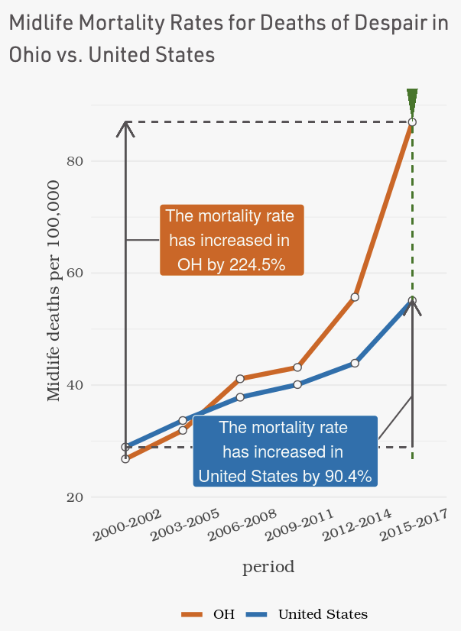
MortalityMinder.idea.rpi.edu
Open source web application enabling healthcare researchers, providers, payers, and policy makers to gain actionable insights into how and why mortality rates are rising in the United States (US)
Explores mortality trends for midlife adults ages 25-64 across the United States from 2000 to 2017.
Identifies social and economic factors associated with increased mortality trends at the county-level for US and individual states.
Visualizations demonstrate determinants and their impact on mortality trends.

Slide 2
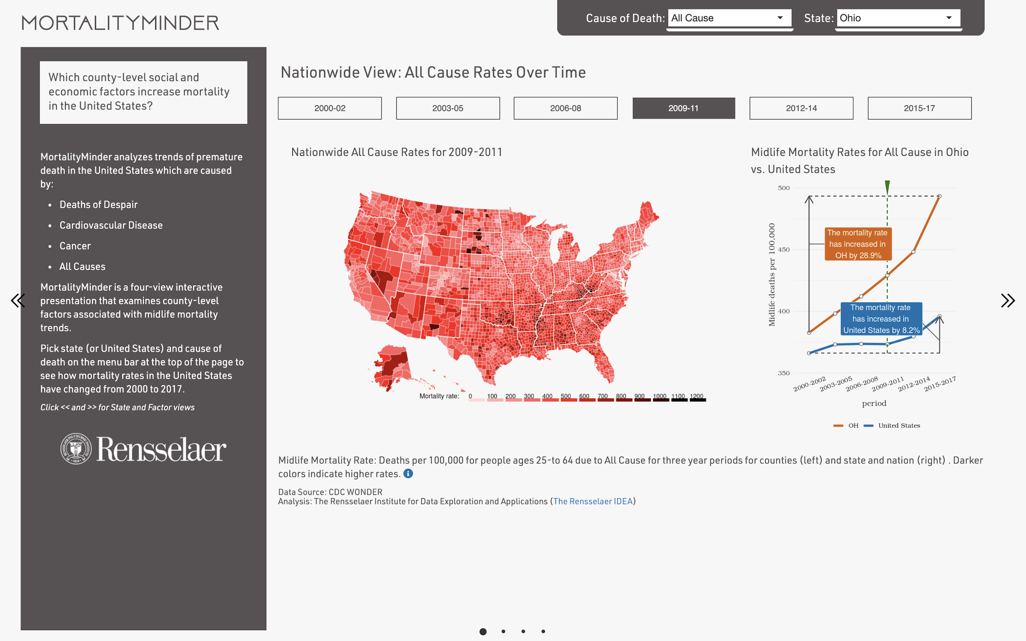
National View reveals national and state mortality trends through time
User selects Cause of Death and State or United States.
Rate Graph reveals change in state and national midlife mortality rates from 2000-2017.
Data for age-specific mortalities are from CDC WONDER.
Users can get more details at the state and factor levels by clicking << or >>.
US map of county-level midlife mortalities exhibits regional differences in mortality.

Slide 3
Data Sources and Preparation
Mortality Rate Data from Wonder.CDC.org from 2000-2017
County-level Social and Economic Factors
From CountyHealthRankings.org
Selected crude midlife detailed mortality rates of adult ages 25-64 because it demonstrate actual premature mortalities rates experienced by Americans.
Calculated mortality rates in three year chunks from CDC Wonder Detail to reveal trends and avoid data suppression. Suppressed data is imputed for visualizations.
Used national, state and county rates for major causes: All Cause, Cancer Deaths, Cardiovascular Deaths, Cancer Deaths, Deaths of Despair (suicide and self harm).
Gathered factors from over 20 primary sources gathered from CountyHealthRankings.org, maintained by Robert Woods Johnson Foundation.
Started with 150 Factors addressing health behaviors, clinical care, education, employment, social supports, community safety and physical environments.
Curated factors and limited to those correlating with at least one cause of death at national level.
Descriptions linked to primary sources.
Open source MortalityMinder easily expands to other age-adjusted, age-specific, and group-specific mortality rates, other death causes, and other features.

Slide 4
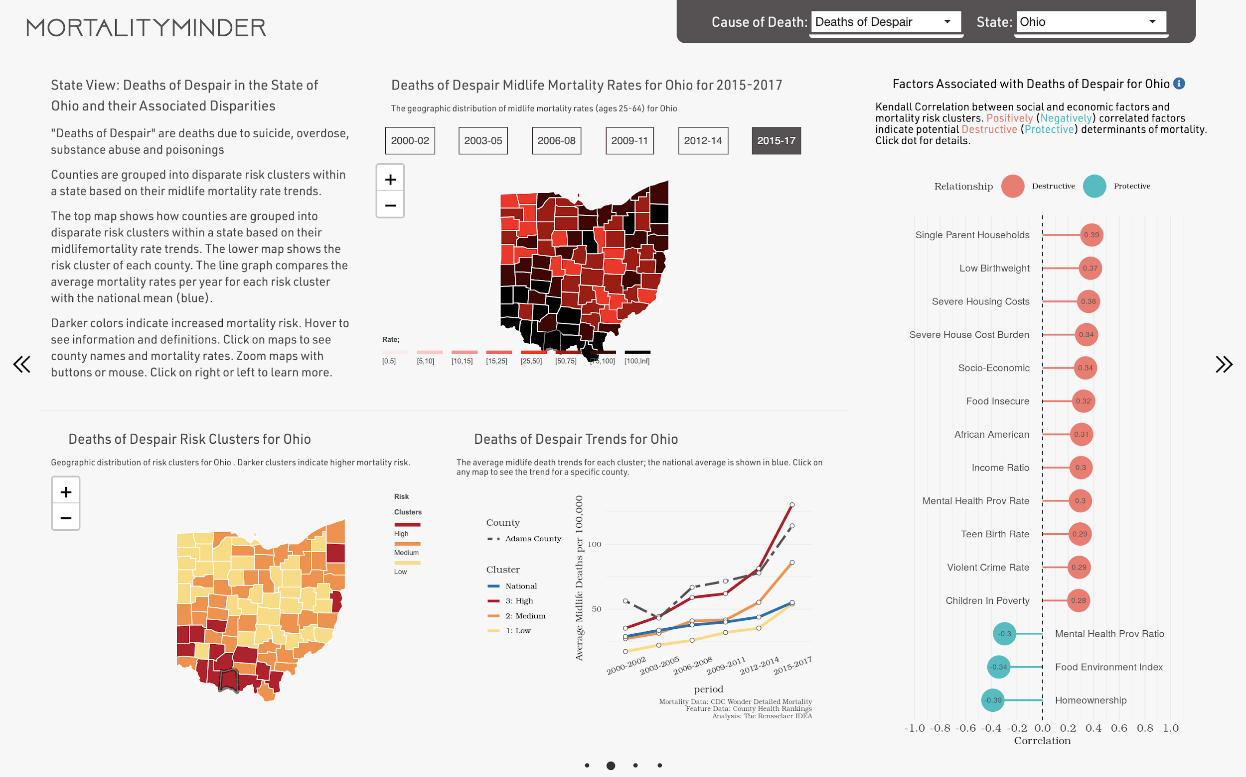
State View: Summarizes within state mortality disparities
County Risk Clusters are found by K-Means clustering algorithm and shown in map to reveal regional disparities. Means provide cluster summaries.
User selects time period shown in the Mortality Rate Map.
Trend Graph highlights regional disparities through time by showing population-weighted mean rates for each risk group. National average through time is shown in blue.
For effective visualization, suppressed mortality rates are imputed. Analysis uses only actual data.
User can select specific county to its data on graph
User selects specific county to show its data on Trend Graph.

Slide 5

State View: Shows Factors Associated with Mortality
Hover on dot to see factor definition.
Click on dot to see details in Factor View.
Performs association study by ordering counties Risk Clusters by 2015-2017 mortality rate, and computes Kendall Tau Correlation between Factors and Risk Clusters.
Reports top 15 significant (p-value < .05) associated factors.
Alternative analysis methods easily added to open source architecture.
Positively-correlated factors are potential Destructive Determinants of mortality.
Negatively-correlated factors are potential Protective Determinants of mortality.

Slide 6
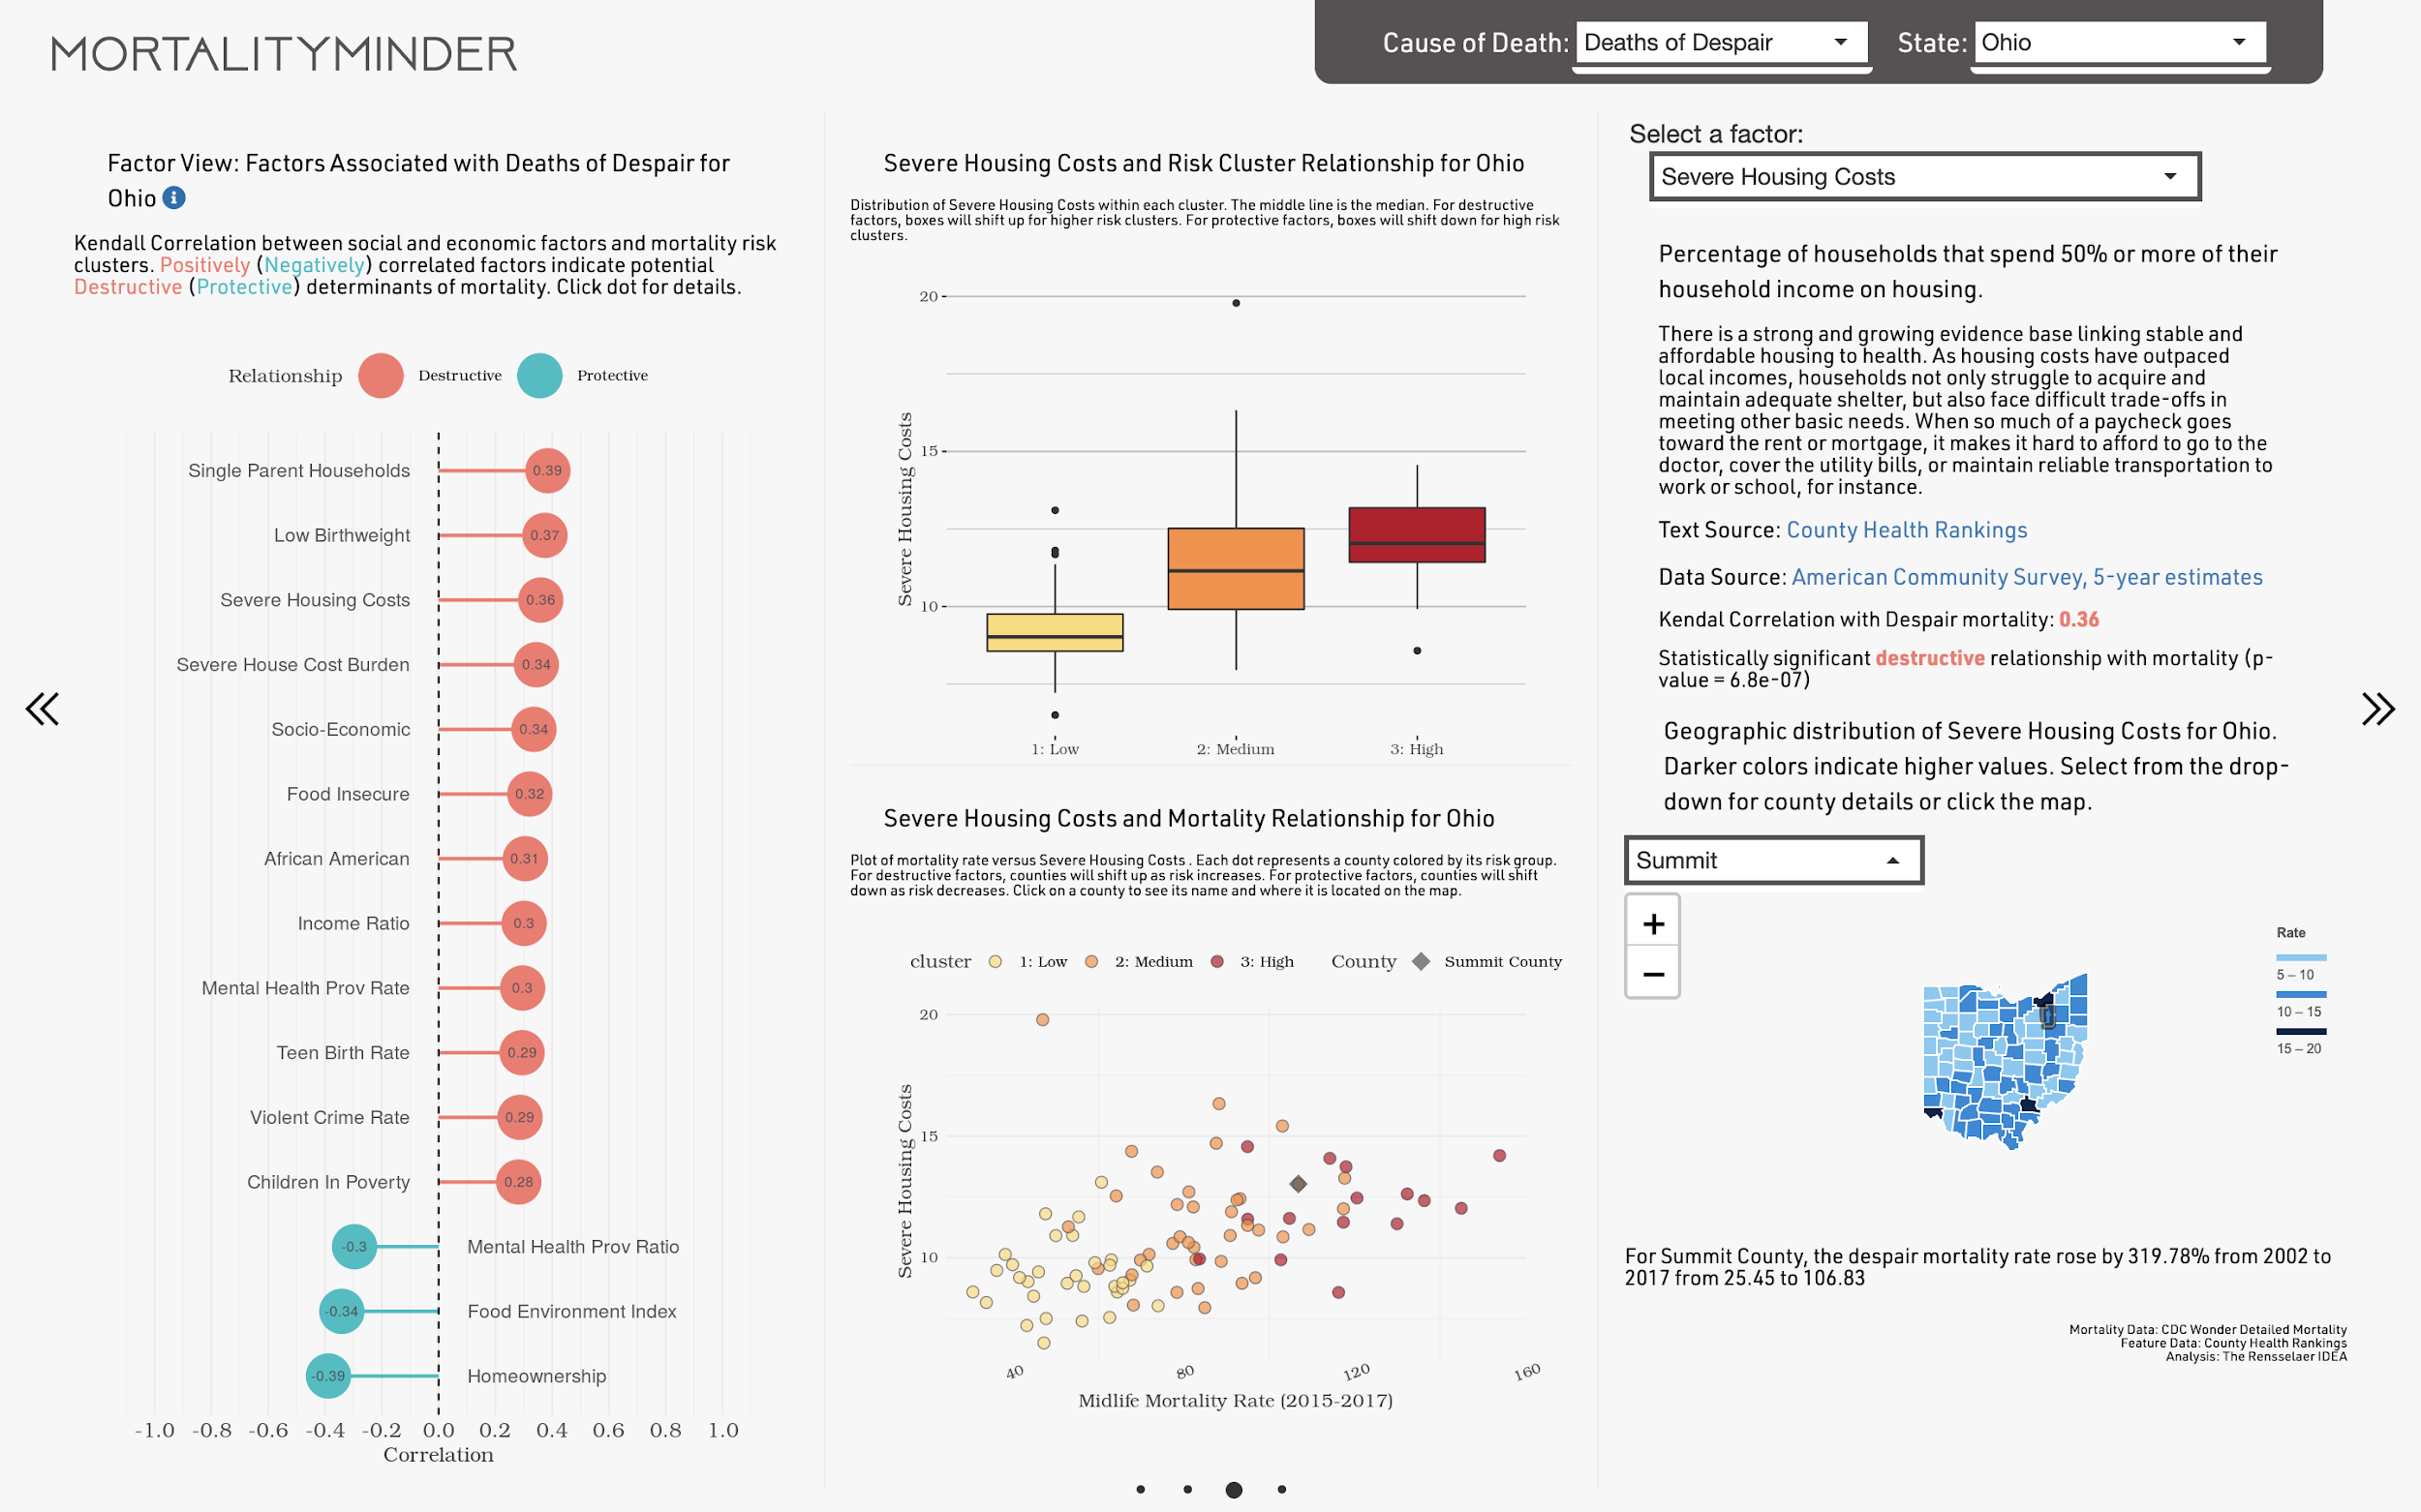
Factor View: Examines potential determinants
Select Factor or click on dot in left column.
Box plots show distribution within each cluster of the selected Factor.
Report on Factor with definitions, links to sources, correlation analysis results, and maps.
Scatter plot shows relationship between selected Factor, Risk Cluster and Mortality Rate. Dots represent counties.
Select a county using dropdown or by clicking on any map.

Slide 7
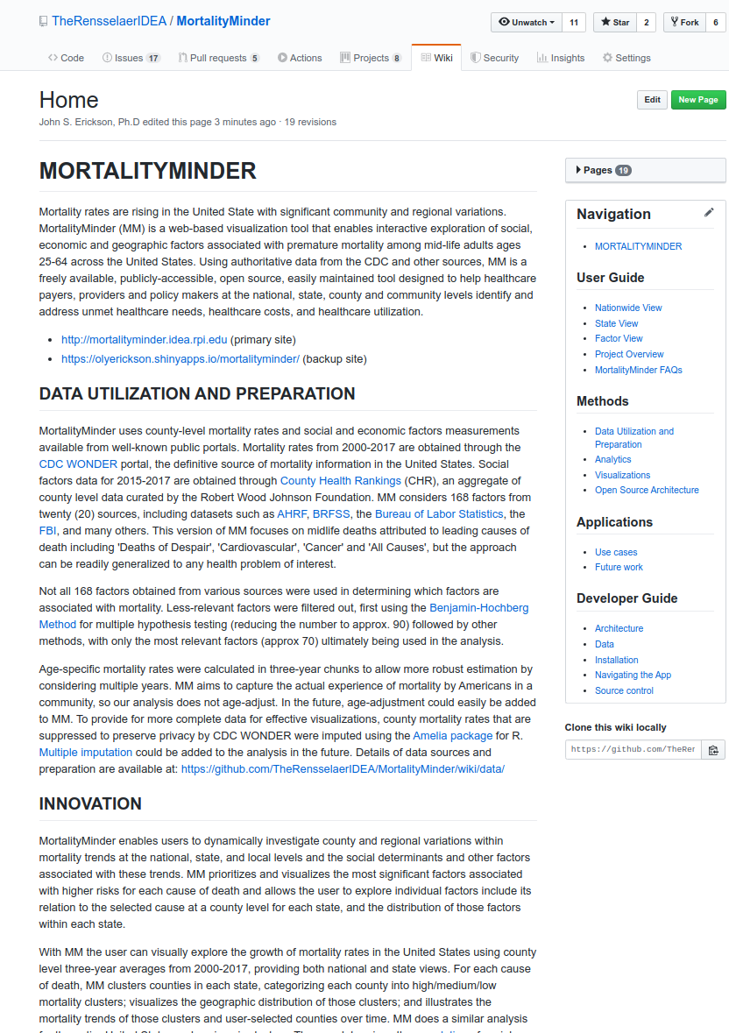
Implementation as Public Open Source Project
Best-practice code and full documentation available on Github
Implemented in open source R language and environment for statistical computing and graphics using standard packages.
Can evolve to address feedback.
Highly Interactive Design
Combines R's Shiny platform with popular Javascript frameworks to provide a modern, highly interactive user experience.
Phase 2 design based on Formal Usability Study (20+ users) and recommendations of advisory board of healthcare and design professionals.
Easily Customized, Reusable, and Maintainable Framework
App can evolve to include new data streams, analyses, visualization, and health care problems.
Readily ingests reliable high-quality surveillance data from wonder.cdc.org and over 20 sources via CountyHealthRankings.org

Slide 8
Insights
MortalityMinder documents the disturbing rise in midlife Deaths of Despair due to suicide, overdose, and self-harm and other national/regional increases in midlife mortality rates due to All Causes, Cancer, and Cardiovascular Disease.
Highlights potential social determinants through statistical analysis of factors associated with disparities in regional trends in mortality rates.
Provides county-level confirmation of trends and hypothesized causes.
Insights can be used to create region-specific interventions and best practices.
Confirms the midlife mortality rate increases in recent literature (e.g. Wolf and Schoomaker, JAMA 2019) but provides much greater insight into community-level variations and their associated factors to help determine remedies.
Enables rigorous analysis of potential determinants of health by local, state, and national healthcare organizations to support development of programs, policies, and procedures to find and address unmet health care needs to improve longevity.

Slide 9
Tool Benefits
Repeatability and Scalability:
Analytical and visualization results are fully repeatable and reproducible, by cloning the GitHub code repository or by directly downloading results via the app.
Users can get analyses at the National, State, and County levels.
The app will scale based on the hosting resources available. It was developed, tested and hosted for the competition on multi-core servers, but performs well on personal machines.
Similar apps could be developed for other health trends and associated social determinants by adding data sources.
Future Deployment:
MortalityMinder is currently hosted on a virtual server at Rensselaer and at Shinyapps.io.
MortalityMinder continues as an open source project dedicated to improving life expectancy in the United States.
The innovative visualizations and analytics in MortalityMinder can be customized and/or incorporated into other applications by using the provided code.
App is designed for use on laptops and monitors. Mobile devices are left as future work.
Long-term plans include expanding analytic methods, exploratory capabilities, and user experience.

Slide 10
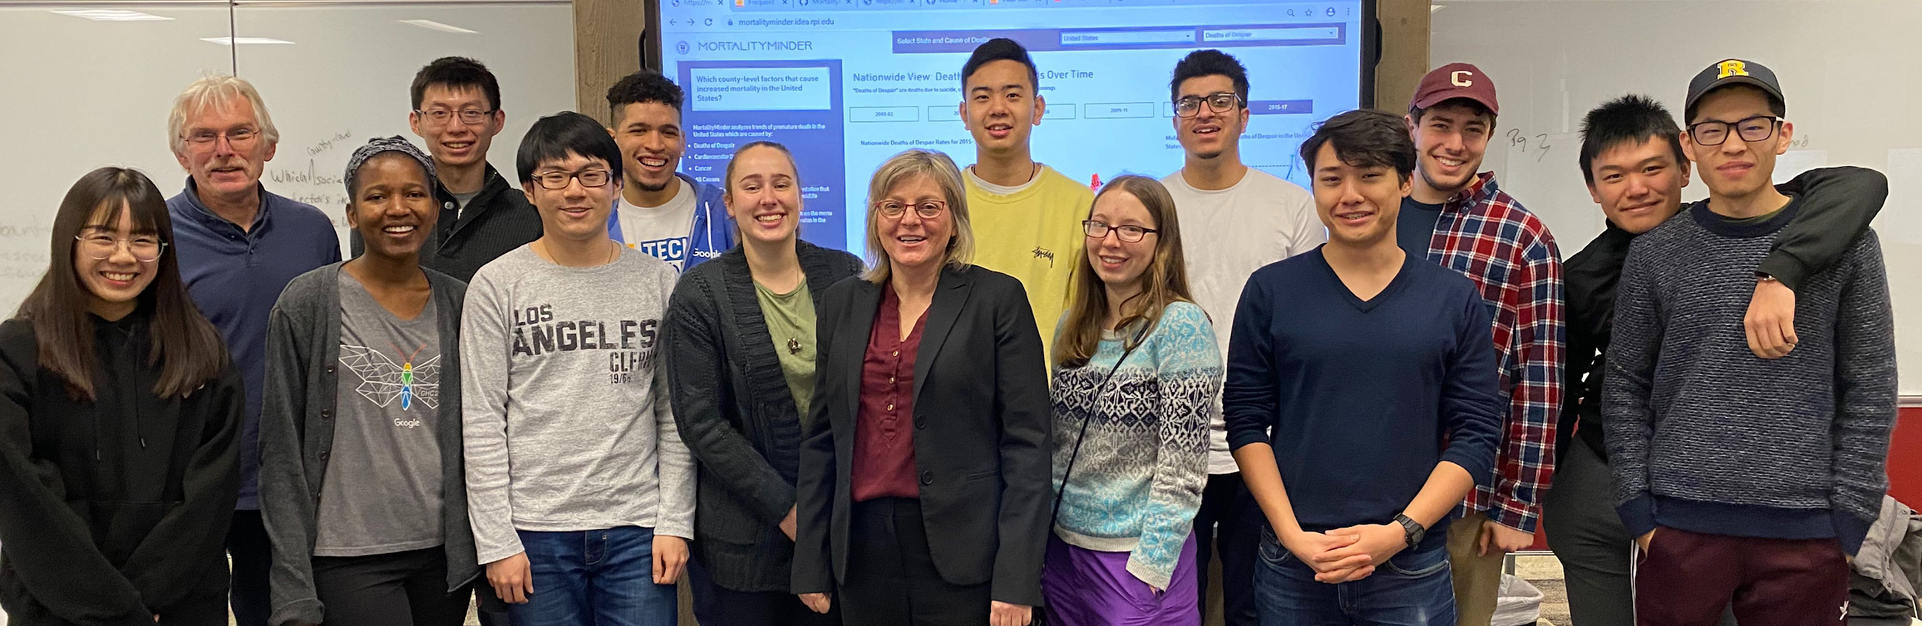
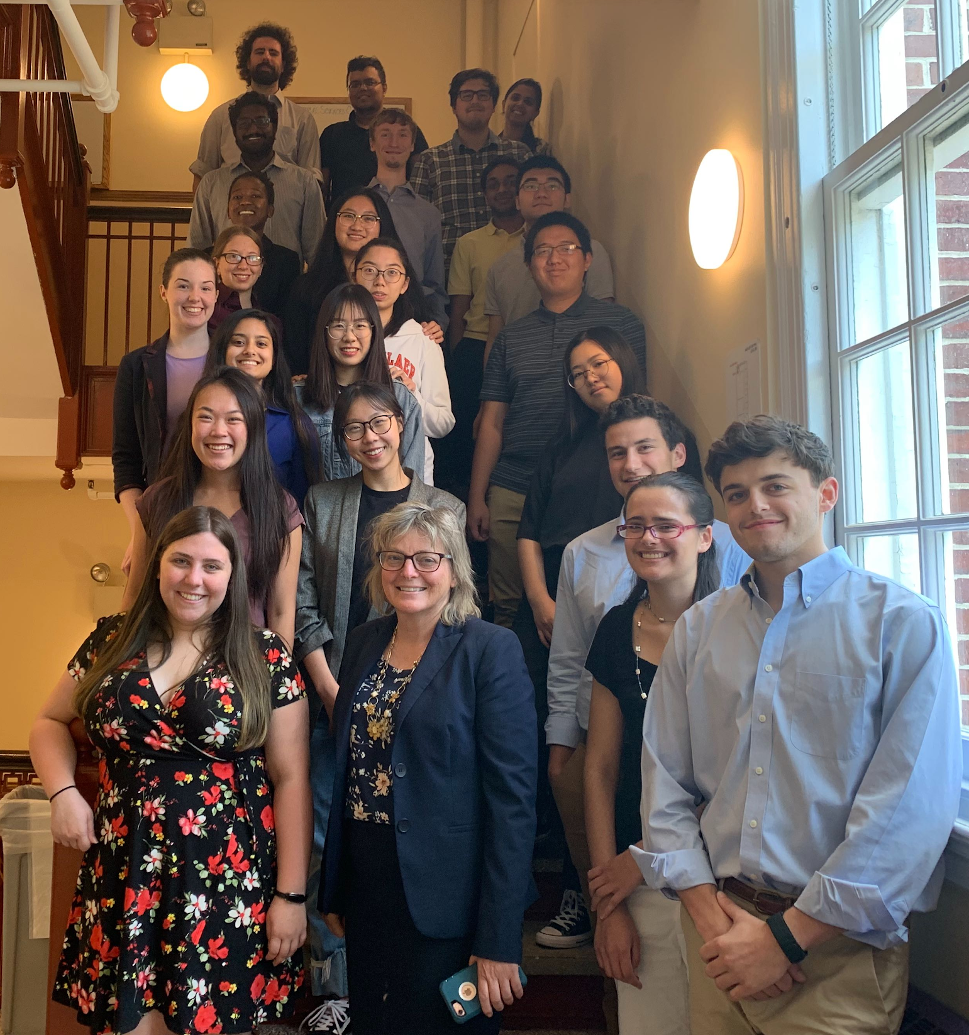
Further Information
MortalityMinder public deployments:
https://mortalityminder.idea.rpi.edu/
https://olyerickson.shinyapps.io/MortalityMinder/
Link to video
MortalityMinder OpenSource GitHub:
https://github.com/TheRensselaerIDEA/MortalityMinder
Full documentation provided on GitHub Wiki
MortalityMinder was created by undergraduate and graduate students in the Health Analytics Challenge Lab at Rensselaer Polytechnic Institute with support from the United Health Foundation and the Rensselaer Institute for Data Exploration and Applications. MortalityMinder was directed by Kristin P. Bennett and John S. Erickson. Many thanks to the MortalityMinder Advisory Board: Ms. Anne Yau, United Health Foundation; Dr. Dan Fabius, Continuum Health; Ms. Melissa Kamal, New York State Department of Health; and Dr. Tom White, Capital District Physicians' Health Plan (CDPHP). Refer questions to: erickj4@rpi.edu or bennek@rpi.edu

